Slide 1
Phase 1: Requirement Specification

Slide 2
Use Case Modeling
Use Case Model
Define system functional requirements in terms of Actors and Use cases
Non-function requirements may be described in use case document

Slide 3
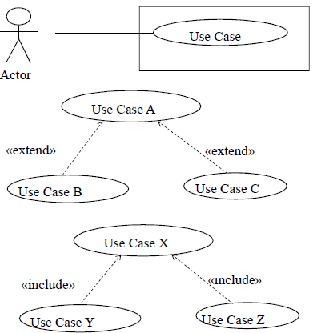
Use Case Modeling
UML notation for use case diagram

Slide 4
Actors
Actors are external to system
Actors interact directly with system
Starts the use case by providing input to the system
Example of Actors:
Human user
External system
Input device
Timer
When actor communicates with actor and bypasses the system
Report stolen card use case
ATM customer sends message to ATM operator
ATM customer talks over the phone to a bank clerk

Slide 5
Actors
Actor initiates interactions with use case
Primary Actor
Starts the use case by providing input to the system
Secondary Actor(s)
Participates in use case
Can be Primary Actor of a different use case

Slide 6
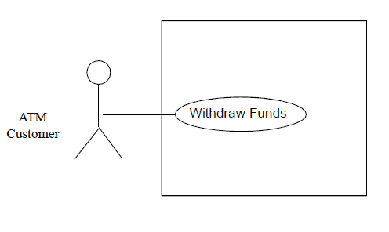
Actors
Example of human user actor

Slide 7
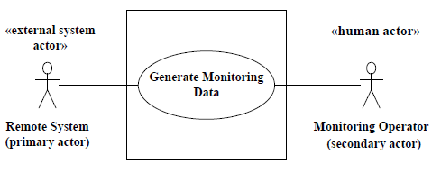
Actors
Example of External system

Slide 8
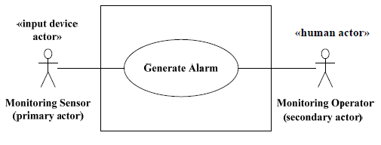
Actors
Example of input device actor

Slide 9
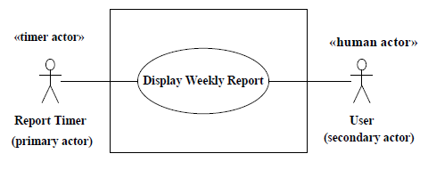
Actors
Example of timer actor

Slide 10
Use cases
Use case
Describes a complete sequence of interactions between actor and system
Starts with input from an actor
Main sequence
Most common sequence of interactions with actor
Alternative sequences
Deviations from main sequence
E.g., for error handling or branches
Not too many small function
Each use case deals with one function from actor perspective
Good use case: Withdraw Funds
Bad use cases: Eject Card, Enter PIN, Dispense Cash, Print Receipt
Use case name: Should describe an action, e.g., Validate PIN

Slide 11
Use cases
Identifying use cases
Start with primary actor
Consider each major function an actor needs
Must provides value to actor

Slide 12
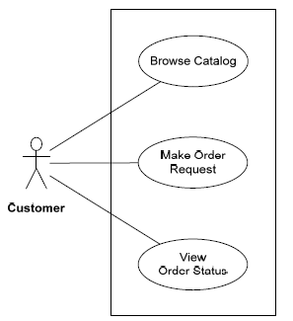
Use cases
Online Shopping System

Slide 13
Use cases
Browse Catalog
Customer browses catalog and selects items
System displays selected items and price
Make Order Request
Customer makes purchase
Customer provides account and credit card info
View Order Status
Customer views status of order

Slide 14
Documenting Use cases
Name
Summary - Short description of use case
Dependency (on other use cases)
Actors – primary, secondary
Precondition(s)
Condition that exists before use case executes
e.g., ATM is Idle, displaying a welcome message
Description of main sequence
Most common sequence
Sentences start with System or Actor, e.g.,
Customer selects payment by credit card
System prompts Customer to swipe card

Slide 15
Documenting Use cases
Description of alternative sequences
Deviations from main sequence
E.g., for error handling
Identify step # where deviation starts
Rejoin main sequence?
Application dependent
Nonfunctional requirements (optional)
Can be specified in a section separated from the use case
Can be specified with use case
Postcondition
Condition that is true at end of use case

Slide 16
Example of Use Case Documentation
Use Case Name: Make Order Request
Summary: Customer enters an order request to purchase items from the online shopping system. The customer’s credit card is checked for sufficient credit to pay for the requested catalog items.
Actor: Customer
Precondition: The customer has selected one or more catalog items.
Description of main sequence:
1. Customer provides order request and customer account id to pay for purchase.
2. System retrieves customer account information, including the customer’s credit card details.
3. System checks the customer’s credit card for the purchase amount and, if approved, creates a credit card purchase authorization number.
4. System creates a delivery order containing order details, customer id, and credit card authorization #.
5. System confirms approval of purchase and displays order information to customer.

Slide 17
Example of Use Case Documentation
Alternative sequences:
Step 2: If customer does not have account, the system creates an account.
Step 3: If the customer’s credit card request is denied, the system prompts the customer to enter a different credit card number. The customer can either enter a different credit card number or cancel the order.
Postcondition: System has created a delivery order for the customer.

Slide 18
Use Case Relationships
Extend and Include relationships
Avoid complexity of use case modeling
Maximize reuse of use cases
Include relationship
Identify common patterns (sequences) of interactions in several use cases
Extract common pattern into inclusion use case
Base use cases include inclusion use case
Inclusion use case might not have a specific actor

Slide 19
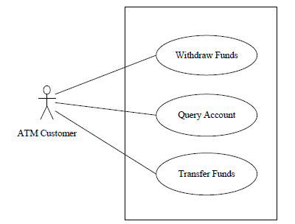
Use Case Relationships
Banking System actor and use cases

Slide 20
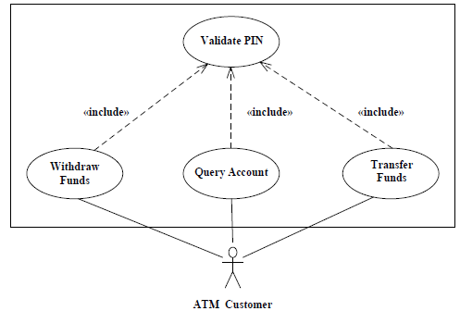
Use Case Relationships
Inclusion use case and include relationship

Slide 21
Example of Inclusion Use Case
Use case name: Validate PIN.
Summary: System validates customer PIN.
Actor: ATM Customer.
Precondition: ATM is idle, displaying a “Welcome” message.
Description of main sequence:
1. Customer inserts the ATM card into the card reader.
2. If system recognizes the card, it reads the card number.
3. System prompts customer for PIN.
4. Customer enters PIN.
5. System checks the card’s expiration date and whether the card has been reported as lost or stolen.
6. If card is valid, system then checks whether the user-entered PIN matches the card PIN maintained by the system.
7. If PIN numbers match, system checks what accounts are accessible with the ATM card.
8. System displays customer accounts and prompts customer for transaction type:

Slide 22
Example of Inclusion Use Case
Alternatives:
Step 2: If the system does not recognize the card, the system ejects the card.
Step 5: If the system determines that the card date has expired, the system confiscates the card.
Step 5: If the system determines that the card has been reported lost or stolen, the system confiscates the card.
Step 7: If the customer entered PIN does not match the PIN number for this card, the system- reprompts for the PIN.
Step 7: If the customer enters the incorrect PIN three times, the system confiscates the card.
Steps 4-8: If the customer enters Cancel, the system cancels the transaction and ejects the card.

Slide 23
Example of Inclusion Use Case
Nonfunctional requirements:
a) Security requirement: System shall encrypt ATM card number and PIN
b) Performance requirement: System shall respond to actor inputs within 5 seconds
Postcondition: Customer PIN has been validated.

Slide 24
Example of Inclusion Use Case
Use Case Name: Withdraw Funds
Summary: Customer withdraws a specific amount of funds from a valid bank account.
Actor: ATM Customer
Dependency: Include Validate PIN use case.
Precondition: ATM is idle, displaying a Welcome message.
Description of main sequence:
1. Include Validate PIN use case.
2. Customer selects Withdrawal, enters the amount, and selects the account number.
3. System checks whether customer has enough funds in the account and whether the daily limit will not be exceeded.
4. If all checks are successful, system authorizes dispensing of cash.
5. System dispenses the cash amount.
6. System prints a receipt showing transaction number, transaction type, amount withdrawn, and account balance.

Slide 25
Example of Inclusion Use Case
7. System ejects card.
8. System displays Welcome message.
Alternatives:
Step 3: If the system determines the account number is invalid, then it displays an error message and ejects the card.
Step 3: If the system determines there are insufficient funds in the customer’s account, then it displays an apology and ejects the card.
Step 3: If the system determines the maximum allowable daily withdrawal amount has been exceeded, it displays an apology and ejects the card.
Step 4: If the ATM is out of funds, the system displays an apology, ejects the card, and shuts down the ATM.
Postcondition: Customer funds have been withdrawn.

Slide 26
Extend relationship
Extend relationship
Model alternative paths that a basic use case may take
A use case B extends a use case A at an extension point if the appropriate conditions hold
Base use case and extension use case
Extension point
The locations in the base use case at which an extension can be added
Designated in description for the base use
Same use case can be extended in different ways
Notation

Slide 27
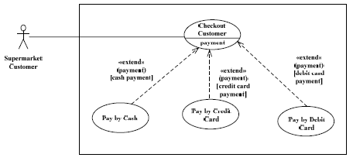
Extend relationship
Example of extend relationship

Slide 28
Extend relationship
Use case name: Check Out Customer.
Summary: System checks out customer.
Actor: Customer.
Precondition: Checkout station is idle, displaying a “Welcome” message.
Description of main sequence:
1. Customer scans selected item.
2. System displays the item name, price, and cumulative total.
3. Customer repeats steps 1 and 2 for each item being purchased.
4. Customer selects payment.
5. System prompts for payment by cash, credit card, or debit card.
6. <payment>
7. System displays thank-you screen.
Alternatives:…..
Post condition:…..

Slide 29
Extend relationship
Use case name: Pay by Cash.
Summary: Customer pays by cash for items purchased.
Actor: Customer.
Dependency: Extends Check Out Customer.
Precondition: Customer has scanned items but not yet paid for them.
Description:
1. Customer selects payment by cash.
2. System prompts customer to deposit cash in bills and/or coins.
3. Customer enters cash amount.
4. System computes change.
5. System displays total amount due, cash payment, and change.
6. System prints total amount due, cash payment, and change on receipt.
Alternatives:…..
Post condition:…..

Slide 30
Extend relationship
Use case name: Pay by Credit Card.
Summary: Customer pays by credit card for items purchased.
Actor: Customer.
Dependency: Extends Check Out Customer.
Precondition: Customer has scanned items but not yet paid for them.
Description:
1. Customer selects payment by credit card.
2. System prompts customer to swipe card.
3. Customer swipes card.
4. System reads card ID and expiration date.
5. System sends transaction to authorization center containing card ID, expiration date, and payment amount.

Slide 31
Extend relationship
6. If transaction is approved, authorization center returns positive confirmation.
7. System displays payment amount and confirmation.
8. System prints payment amount and confirmation on receipt.
Alternatives:…..
Post condition:…..

Slide 32
Non-Functional Requirements
Quality of service goal that system must fulfill
Also called software quality attribute
Should be measurable
Some Non-Functional Requirements
Availability Requirement
Performance Requirement
Security Requirement
Scalability Requirement

Slide 33
Non-Functional Requirements
Availability Requirement
Extent to which system is operational for users
E.g., system shall be operational for 99% of time
Performance Requirement
System throughput and/or response time goal
E.g., system response to user inputs shall not exceed 2 seconds
Security requirement
Ability to protect information and system resources
E.g., system shall encrypt ATM Card Id and PIN
Scalability requirement
Capability of system to grow beyond initial system deployment (installation)
CPU, main memory, and secondary storage shall be capable of expansion of 30% after initial system deployment

